Slide 1
UK Heavy Duty Vehicle CO₂ emission regulations
Manufacturer workshop
9 September 2021

Slide 2
Agenda
Time | Item | Speaker
13:30 | Introduction and Background | DfT
13:45 | Submitting your data return | VCA
14:15 | Questions for VCA | All
14:45 | Comfort break if needed
15:00 | Summary of the draft guidance and addressing key concerns | DfT
15:20 | Future and prospective amendments | DfT
15:30 | Questions and discussion | All
16:00 | End of workshop

Slide 3
Present situation

Slide 4
Present situation
The new UK heavy duty vehicle CO₂ emissions regulations are in force as of 1 January 2021.
Two Statutory Instruments (SIs) are currently in force alongside the retained EU Regulations – SI 2019/846 & SI 2020/1402.
The VCA is the nominated enforcement body for the regulations.
The regulatory regime will require amendments from time to time to ensure they continue to function, and to legislate where gaps appear. We plan to make additional amendments on the regulations, and any such amendments will be trialled in this Technical Working Group first.

Slide 5
Data collection

Slide 6
Information to be provided to the VCA by manufacturers:
the manufacturer name indicated in the certificate of conformity or individual approval certificate;
the World Manufacturer Identifier code(s) (WMI code) as defined in Commission Regulation (EU) No 19/2011 to be used in the vehicle identification numbers of new heavy-duty vehicles to be placed on the market;
the name and email address of the contact person responsible for uploading the data to the VCA database
We request that this information is sent as soon as possible via email to the VCA at:
fleetaverage@vca.gov.uk

Slide 7
Data to be provided to the VCA from manufacturers
The data specified in point 2 of Part B of Annex I for each new heavy-duty vehicle certified in the UK* between 1 July and 30th June of the reporting period.
For vehicles registered until 30 June 2021 where available and for vehicles registered from 1 July 2021 in all cases, the specific CO₂ emissions as specified in entry 49.5 of the Certificate of Conformity
*Including Northern Ireland as HDVs are excluded from the Northern Ireland Protocol

Slide 8
Requirements for the uploading of HDV CO₂ data by manufacturers
The named contact person for each manufacturer will be provided with a user name and password which will allow them access to the VCA’s HDV CO₂ database, and detailed instructions of how to upload their data via the portal.
Each manufacturer is responsible for ensuring that any updates regarding named persons is reported to the VCA and that their user name and password are not shared with anyone else.
The VCA requires that the UK data uploaded via the portal is in the same XML format as used to report CO₂ emission data to the European Commission.

Slide 9
Process for uploading the CO₂ datafile to the VCA
Log in to the HDV section of the VCA database using the user name and password provided by the VCA.
Click on the “Upload data” button to upload your UK data. The system will only accept submissions that are a single XML file.
The system will run a basic check on the data and report on any errors it finds in the data.
The system will inform you if your data has been loaded successfully or if an error has occurred when loading the data.
Each manufacturer will be able to view their own data once successfully loaded.

Slide 10
Calculations and Publication of the dataset
For each manufacturer, the VCA will calculate;
the provisional CO₂ emissions target for the reporting period
the actual CO₂ emissions performance of each manufacturer
the difference between the two figures and whether the manufacturer has met their emission target.
By the 30th June of the following year, this dataset shall be notified to manufacturers and published on the VCA website; Average Emissions Monitoring - Vehicle Certification Agency (vehicle-certification-agency.gov.uk)

Slide 11
The Guidance Document
The guidance document is already online for you all to have a look at:
https://www.vehicle-certification-agency.gov.uk/publication/hdv-co2-regulations-guidance-draft/
It contains a breakdown of what the regulations require of government and manufacturers.
Fundamentally, this is all the same as the EU regime was, as the regulations are transposed.
The Heavy Duty Vehicles regulations are much simpler than the cars and vans ones, with currently no pooling, eco-innovations etc.
Until 2025 there is no enforcement, just data collection and potentially accumulation of credits.

Slide 12
New Data Collection
As discussed, the data in Part B of Annex I of the regulations, which was previously send to the EU, will now be sent to the VCA.
There are also data collection requirements in Part A of Annex I. The vast majority of these are already collected by the DVLA through the registration process. However just before the end of 2020, the EU added a few extra data fields, the collection of which caused concern for UK based manufacturers.
The only additional data provision ask on manufacturers as part of this regime is that they provide “the specific CO₂ emissions as specified in entry 49.5 of the Certificate of Conformity”. This they can send in alongside the above data return to the VCA.

Slide 13
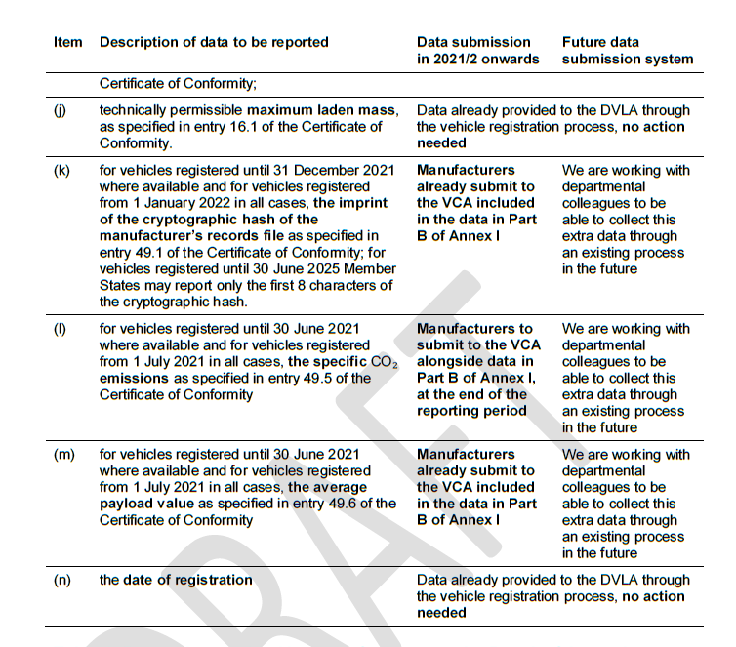
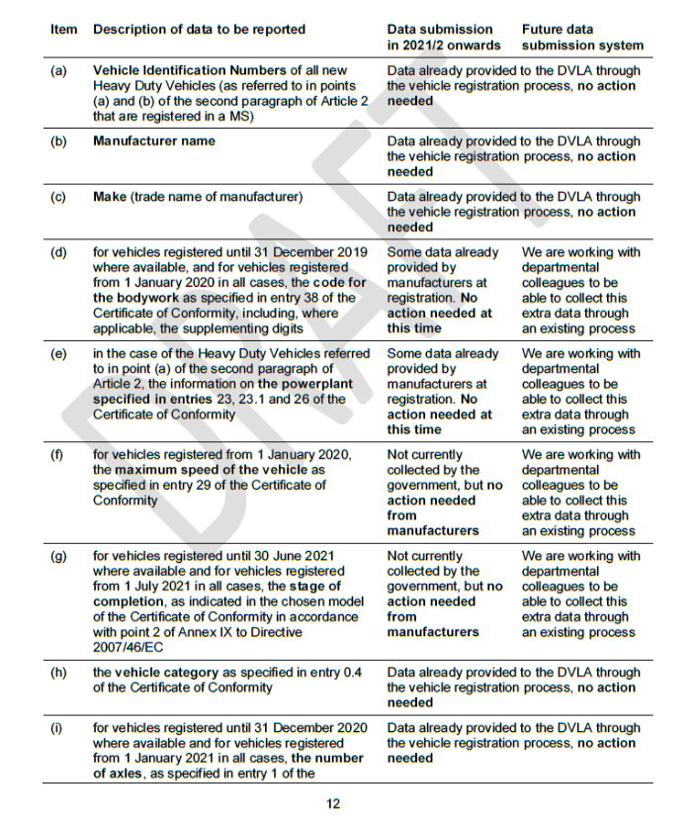
New Data Collection

Slide 14
Future and Prospective Amendments

Slide 15
Future Amendments
As part of the retained regime, the SoS has a number of regulation-making abilities designed to complement/expand the existing regime. These are –
Art 7(2), 2018/956 – data reporting regarding on-road verification tests
Art 8(4), 2018/956 – verification and correction measures in respect of data errors
Art 9(2), 2018/956 – establish a procedure for the collection and administration of fines relating to data reporting
Art 11(1), 2018/956 – amendment of data collection requirements in accordance with the reasons listed in the provision
Art 8(3), 2019/1242 - establish a procedure for the collection and administration of fines relating to excess CO2 emissions
Art 9(3), 2019/1242 – setting out procedures for reporting deviations in CO2 monitoring data and taking them into account in respect of calculating average CO2
Art 10, 2019/1242 – methodology for assessing the application of conditions under which reference emissions have been determined, and determining whether those emissions have increased
Art 12(2), 2019/1242 – procedure for capturing and processing real-world emissions data
Art 13(4) , 2019/1242 – performing verification of HDV CO2 emissions in-service (and setting out guiding principles in advance)
Art 14(1), 2019/1242 – amendments to Annex I/II for specific reasons
Art 14(2), 2019/1242 – adjustment if Type Approval changes beyond the criteria in 14(1), causing a change of at least 5g CO2/km
Art 14(3), 2019/1242 – methodology for defining one or more representative for each vehicle sub group

Slide 16
Future Amendments
Currently, only one regulation-making power is actively being considered, regarding the collection of fines for data reporting/excess emissions premiums.
While the penalties are set out in both regulations, neither regulation currently has a procedure for issuing such a penalty.
That being said, other amendments to the regulations will clearly be needed in due course.

Slide 17
Future Amendments
Earlier this week, the EU adopted 2 new delegated regulations –
2021/1429 – amending data collection requirements in order to identify special purpose vehicles;
2021/1430 – specifying the data to be reported by EU Member States for the purposes of verifying the CO2 emissions and fuel consumption of new HDVs.
These new EU regulations do not directly apply in the UK/will not be retained in UK law.
In these particular areas, DfT officials will consider what amendments will work best in the UK, and we are happy to take views.

Slide 18
Contact Details
VCA (the enforcement body)
fleetaverage@vca.gov.uk
Environment Strategy (policy)
environmental.strategy@dft.gov.uk
Vehicle Statistics
vehicles.stats@dft.gov.uk
DVLA
VED.Reform@dvla.gov.uk or Basecamp

Slide 19
Any Other Business

Slide 20
Thank you for attending

