Slide 1

GB car and van CO₂ emission regulations
Manufacturer workshop
30 March 2021

Slide 2
Agenda
Time | Item
9:30 | Introductions
 | Background
 | Performance and target calculations
 | Flexibilities – pooling, super-credits, eco-innovations etc
Approx. 11:00 | Break for 15 mins
 | Northern Ireland Protocol
 | Future and prospective amendments
 | AOB
12:30 | Close of workshop

Slide 3
Present situation

Slide 4
Present situation
The Great Britain car and van CO₂ emissions regulations are now in force.
Two Statutory Instruments (SIs) currently in force SI 2019/550 and SI 2020/1418.
The VCA is the nominated enforcement body for the regulations.
We plan to make additional amendments on the regulations, such as encompassing Northern Ireland into the regime and correcting the eco-innovations that were approved in the EU, in late 2021.

Slide 5


Performance and target calculation

Slide 6
Average Emissions data collection activities – 2021 onwards
From 2021, VCA will be responsible for;
Processing, assessing and publishing applications for pooling, eco-innovations and derogations.
From 2022, the VCA will be responsible for;
Calculating manufacturer’s or pools of manufacturers’ emissions target for passenger cars and light commercial vehicles.
Calculating manufacturer’s or pools of manufacturers’ specific CO₂ emissions for each reporting year.
Calculating and issuing excess emissions premiums.

Slide 7
Timeline
28 February
30 June
31 October
+ 3 months
VCA receive data from DfT
Manufacturers report any errors in data to VCA
VCA publish provisional dataset & send to manufacturers
VCA publishes finalised dataset

Slide 8
Annual data return process
DVLA
Provide monthly extracts of new registration records (AFRL) along with supplementary datasets (e.g. RaV)
DfT
By end February
Merge all datasets
Validate vehicle records
Prepare XML file
Send to VCA
DfT
March / April
Resubmit XML file with corrections
VCA
Review dataset provided
Publish provisional results
Work with manufacturers on their error notifications
Manufacturers
Review provisional results and raise error notifications with VCA
DfT
May onwards
Help VCA resolve any disagreements with the provisional dataset
VCA
Initial rapid validation
Report back any immediate or obvious data issues (e.g. file corruption)
Manufacturers
Provide occasional supplementary data to resolve registration issues
VCA
Make final decision on revisions
Publish final results
Calculate targets, issue fines etc.

Slide 9
Calculations
VCA will be calculating manufacturer’s/pool’s emission targets and specific emission figures using the same calculations as the EU and as set out in Annex 1 of Regulation 2019/631 as amended.
WLTP target specific calculation
When calculating the WLTP reference target for both cars and vans it shall be done using a manufacturer and/or pool’s EU values for all of the required data fields.
The VCA shall use the dataset published by the European Commission in respect of the 2020 reporting period to derive the WLTP specific emissions reference target in the UK.
M_{ø} and M_{ø2020} = average mass of vehicles in running order in the UK

Slide 10
Excess Emissions Premium
If a manufacturer or a pool has exceeded their emissions target, they will be issued with an excess emissions premium.
The amount payable will be £86 per gram of exceedance multiplied by the number of vehicles registered.
The excess emissions premium will be issued in the form of a civil penalty and will be sent either to the nominated contact point for the manufacturer or to the pool manager.
Excess emissions premiums must be paid within 28 days unless an appeal to the First Tier Tribunal is made.
A manufacturer or pool has the right to appeal to the First Tier Tribunal.

Slide 11
Questions
What are your thoughts on the current process for validating and verifying the data?
  What are you happy with?
  What could be improved?
Are you happy with the process for raising concerns with the provisional dataset?
Would you be interested in discussing vehicle records with the DfT statistics team earlier in the process when they’re working on the initial return?

Slide 12
Questions?

Slide 13
Flexibilities

Slide 14
Flexibilities
Flexibility | Deadline for application
Super-credits
Eco-innovations
Pooling | 31 October 31 December for amendments
Derogations | 31 October

Slide 15
Super-credits
Under the GB scheme, manufacturers will be eligible to receive super-credits for registering zero or low emission vehicles (ZLEVs) into the GB market. These credits can then be used against emission targets.
Super-credits are applied automatically, and therefore must be used if vehicles are eligible.
For 2021 and 2022, each ZLEV produced will count as 1.67 and 1.33 cars, respectively.
Manufacturers may benefit from a maximum of 3.75g CO₂/km reduction in their specific emissions of CO₂ performance over this period. This cap is based on WLTP values.

Slide 16
Eco-innovations
Manufacturers will continue to be able to receive 'credits' for eco-innovations.
All eco-innovations that had been approved for use as CO2 emissions reduction technologies, before 31 December 2020, will continue to be approved for use in the UK as CO2 emissions reduction technologies.
An application for any new eco-innovation will need to be approved separately in the UK from the 1 January 2021.

Slide 17
Eco-innovations in 2021
Any eco-innovations that are approved by the European Commission in early 2021 will be approved in the UK in the same manner.
This approval will not be automatic. Manufacturers and parts suppliers who have a new eco-innovation, newly approved in the EU, will still be required to apply for approval in the UK.
VCA will assess eco-innovation applications in the same manner, and using the same methodology, as in the EU.
Manufacturers/parts suppliers will be asked to provide all of the information that they have previously provided to the European Commission to VCA.

Slide 18
New eco-innovations testing
Manufacturers will continue to be able to use technical services within Europe and the UK that are recognised as such by the EU Type Approval Framework Directive.
Manufacturers or parts suppliers will not have to 'double-test' their product in the EU and the UK.

Slide 19
New eco-innovation approval
Manufacturers are requested to inform VCA if the eco-innovation has been approved by the EU before VCA has come to a decision.
If a technology has been approved by both the EU and UK, then the code used on the Certificate of Conformity in the UK to be the same as it is within the EU.
If an application has only been made in the UK, then it is intended that the code to be used on the Certificate of Conformity shall start from 99 and will countdown by 1 for every approved application afterwards.
If an application is subsequently made to the European Commission, and the application is approved, it is intended for the UK only eco-innovation code e.g. 99, to be replaced by the number mandated by the European Commission.
The 7g CO₂/km savings cap for eco-innovation is based on WLTP values.

Slide 20
Derogations
Any manufacturer that had an approved EU derogation for 2021 may continue to use that same derogation in respect of their UK registrations in 2021.
Any manufacturer that has an active derogation in 2021, and wishes to continue to receive a derogation in 2022, will need to reapply in the UK.
Manufacturers that have an active EU derogation in 2021 that has been retained in UK law may also apply for a UK-derived derogation in 2021.
For both cars and vans, manufacturers will receive individual thresholds based on the percentage of EU sales in 2017 that occurred in the UK, and on the original EU derogation thresholds of 300,000/10,000 cars and 22,000 vans.
Manufacturers can currently only apply for a derogation up until 2024 as thresholds change in 2025.
The de minimis threshold will remain at 1,000 vehicles for cars and vans.

Slide 21
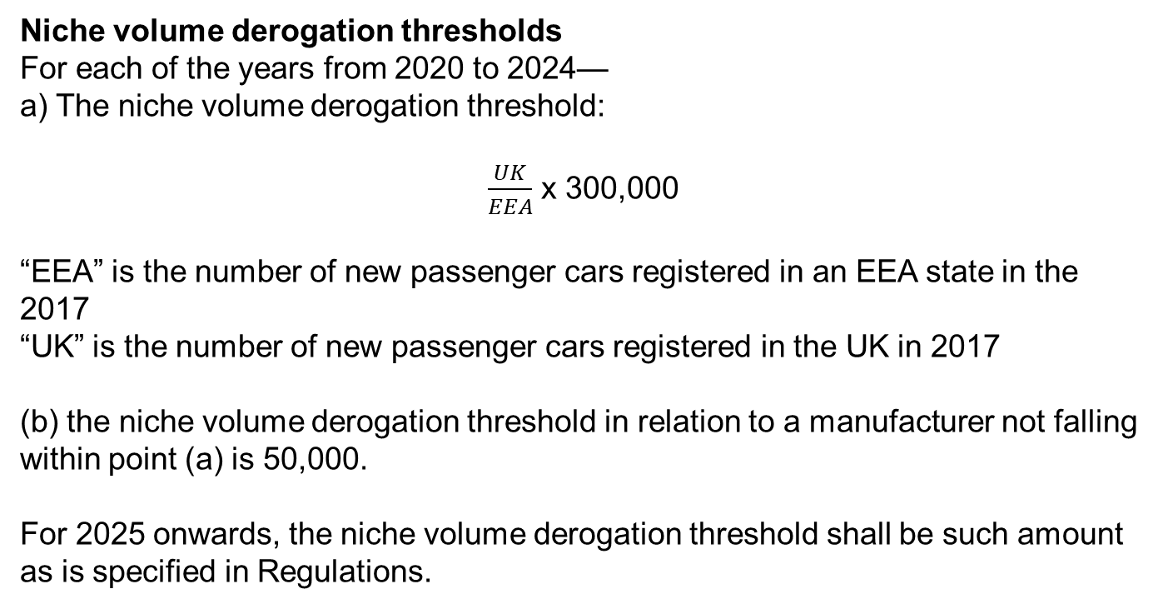
Niche volume derogations
Niche volume derogation thresholds
For each of the years from 2020 to 2024—
a) The niche volume derogation threshold:
$\frac{UK}{EEA}$ x 300,000
“EEA” is the number of new passenger cars registered in an EEA state in the 2017
“UK” is the number of new passenger cars registered in the UK in 2017
(b) the niche volume derogation threshold in relation to a manufacturer not falling within point (a) is 50,000.
For 2025 onwards, the niche volume derogation threshold shall be such amount as is specified in Regulations.

Slide 22
Niche volume derogations applications
Applications must be submitted before 31 October of the first year in which the derogation is requested to apply from, and the derogation may last for no more than 5 years. The first year under the GB scheme applications can be sent in is 2021.
If approved, the target shall be a 45% reduction based on the manufacturer's average specific emissions of CO₂ for their UK fleet in 2007.
If 2007 figures do not exist, the VCA shall determine an equivalent reduction target based upon the best available CO₂ emission reductions technologies deployed in cars of comparable mass, and taking into account the market for the type of car being manufactured.

Slide 23
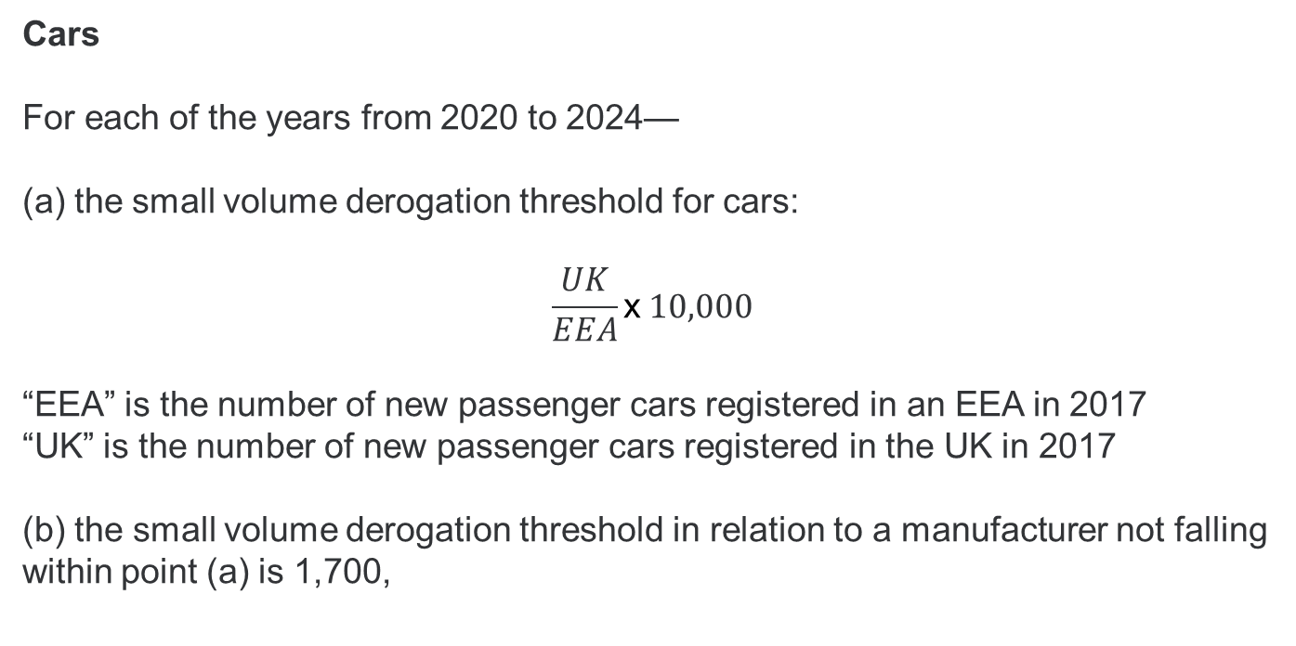
Small volume derogation thresholds
Cars
For each of the years from 2020 to 2024—
the small volume derogation threshold for cars:
$$\frac{UK}{EEA}\text{x} 10,000$$
“EEA” is the number of new passenger cars registered in an EEA in 2017
“UK” is the number of new passenger cars registered in the UK in 2017
(b) the small volume derogation threshold in relation to a manufacturer not falling within point (a) is 1,700,

Slide 24
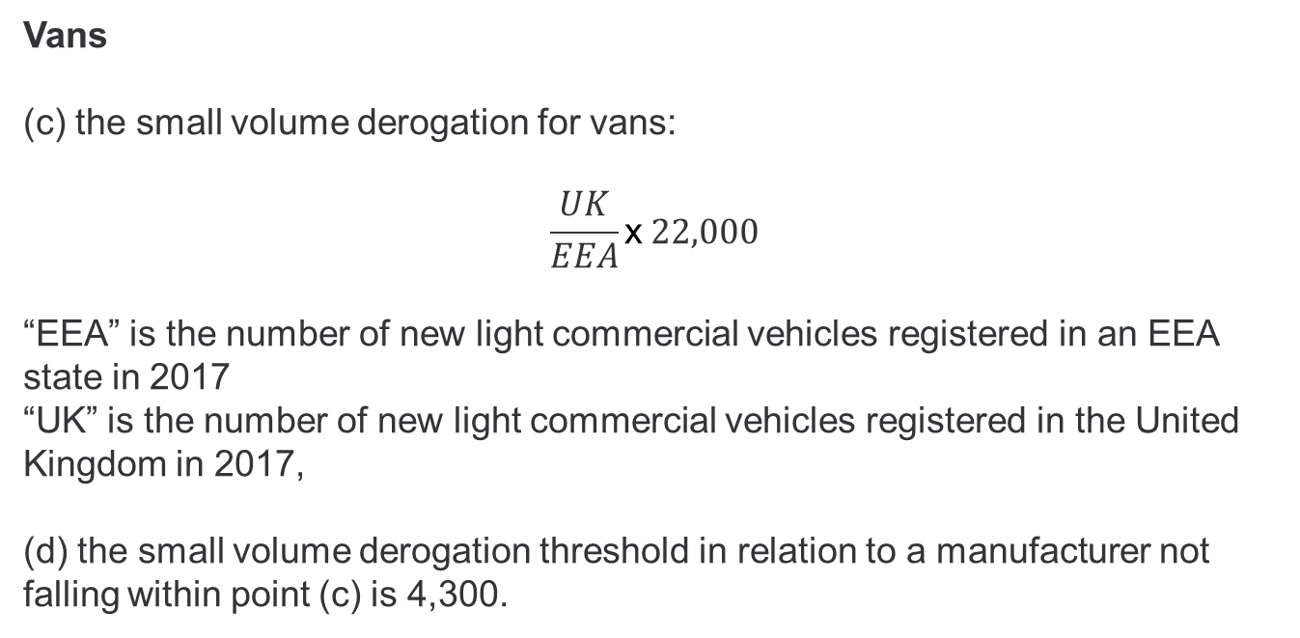
Small volume derogation thresholds
Vans
(c) the small volume derogation for vans:
$$\frac{UK}{EEA}\text{x} 22,000$$
“EEA” is the number of new light commercial vehicles registered in an EEA state in 2017
“UK” is the number of new light commercial vehicles registered in the United Kingdom in 2017,
(d) the small volume derogation threshold in relation to a manufacturer not falling within point (c) is 4,300.

Slide 25
Small volume derogation applications
Applications must be submitted before 31 October of the first year in which the derogation is requested to apply from, and the derogation may last for no more than 5 years. The first year under the GB scheme applications can be sent in is 2021.
If approved, the target shall be as agreed between the manufacturer and the VCA. The VCA shall assess the proposed CO₂ emissions target based upon the manufacturer's reduction potential (both economic and technological) and based upon the characteristics of the market for the type of vehicle manufactured.
As this will be a bespoke target, no conversion is required, as the target will be set using WLTP values.
Existing EU-derived targets in 2021, these will be converted in the same manner as niche-volume derogated targets, using the full EU dataset.

Slide 26
Pooling
Manufacturers continue to have the opportunity to pool their registrations together and be considered as one entity.
Existing pooling arrangements have not been retained in the UK following EU Exit.
Manufacturers are not compelled to form the same pools for their UK registrations.

Slide 27
Pooling applications
Any application to form a pool must be submitted to the VCA, and must be made in accordance with Article 6 of Regulation 2019/631 as amended.
Applications must be submitted before 31 October of the first year in which the pool is requested to apply from, and the pool may last for no more than 5 years.
VCA will publish the intent to form a pool on the VCA website. A 30-day window will then open for other manufacturers to apply to the pool manager to join the pool.
You can find an application form to apply to pool on the VCAs website.

Slide 28
Annual deadlines for manufacturers
2021 Deadlines for manufacturers
Date | Action
31 May (2021 only) | Manufacturers contact information to be sent to VCA
No later than 31/10/2021 | Manufacturers to declare an intent to form a pool for the 2021 reporting year
No later than 31/10/2021 | Manufacturers to apply for a derogation for the 2021 reporting year
No later than 31/12/2021 | Manufacturers to submit an application to amend a pool
From 2022 onwards, Additional deadlines for manufacturers
Date | Action
30 September 2022 (3 months from receiving provisional 2021 dataset) | Manufacturers to submit any corrections or amendments of provisional dataset to VCA

Slide 29
Questions?

Slide 30
Break for 15 minutes

Slide 31
Northern Ireland Protocol

Slide 32
Northern Ireland Protocol
Northern Ireland Protocol was agreed (subject to ratification) on 17 October 2019.
At the time, Regulations 443/2009 and 510/2011 were listed in Annex 2 of the Protocol.
As successor regulations were deemed to be in scope, this meant that as of 1st January 2020, Regulation 2019/631 was also in scope.
This would have meant that the EU version of 2019/631 would have had continued effect in Northern Ireland.

Slide 33
Northern Ireland Protocol
The Joint Committee decided to remove Regulations (EC) 443/2009 and (EU) 510/2011, and in effect (EU) 2019/631 from Annex 2 of the Northern Ireland Protocol (NIP) in late 2020.
As a result, Northern Ireland is now not captured by either the EU or GB car and van CO₂ emission regulatory regime.

Slide 34
Extending the GB CO₂ emission regime to Northern Ireland
The UK Government will now extend the current GB car and van CO₂ emission regime to Northern Ireland.
A statutory instrument (SI) is going to be laid in late spring to bring Northern Ireland into the framework.
Once the SI is made (predicted June/July), vehicles registered in Northern Ireland can from then on count towards a manufacturers 2021 CO₂ emission target. Vehicles registered prior to the making date will NOT count towards targets.

Slide 35
Questions?

Slide 36
Future amendments

Slide 37
Future amendments: UK M0 value
The EU did not legislate for a new EU passenger car M0 value before the end of 2020, therefore no value was retained. ​
The UK will now legislate for a UK specific M0 value for passenger cars for 2022 to 2024.​
Provisional UK M0 value is 1,439kg (based on 2017, 2018 and 2019 provisional data).
Notes:
Alex

Slide 38
Future amendments: correcting EU approved eco-innovations
Both Implementing Decisions (EU) 2020/1806 and (EU) 2020/1714 entered into force in the EU in late 2020.
Both Decisions were retained in UK law. However, SI 2020/1418 did not correct them due to their late approval.
The UK will now correct these two eco-innovations, alongside (EU) 2020/1339 and (EU) 2019/1119 as amended, to ensure they work properly in UK legislation.
Notes:
Alex

Slide 39
Future amendments: Revoke all EU derogations for 2022 ​
In 2021, all EU granted small and niche volume derogations were retained in UK legislation​.
The UK will revoke all EU granted derogations effective from 1 January 2022.
In 2021, manufacturers with an EU granted derogation may still apply for a UK specific derogation if they wish to.
Any manufacturer with an active derogation registering <1,000 new vehicles in 2021 will be out of scope.
Notes:
James

Slide 40
Prospective
amendments

Slide 41
Prospective amendments: WLTP and derogation calculation amendments
There are outstanding legislative gaps in 2019/631 as amended by SI 2020/1418, relating to WLTP target and derogations calculations. For example, how a manufacturer calculates their WLTP specific emissions reference target if their fleet had zero emissions in 2020.
The UK is considering what amendments to make and will provide further details in due course.
Notes:
James

Slide 42
Prospective amendments: Real world CO₂ emissions data
Regulation 2019/631 as amended by SI 2020/1418 obligates the UK government to collect real world CO₂ emissions data including, fuel/energy consumption data from new cars and vans registered in 2021 onwards.
The UK is looking into how this data may be collected and who will be responsible. More information will be provided in due course.
Notes:
James

Slide 43
Prospective amendments: Updating contact details
In both SI 2019/550 and SI 2020/1418, the contact details provided are for Environment Strategy, not the VCA.
The UK is considering how best to change these contact details from Environment Strategy to the VCA’s, as they are now the enforcement body for the regulations.
These changes will also consider how we can apply a digital first approach to all aspects of the regulation.
Notes:
Alex

Slide 44
Prospective amendments: New approvals publishing process
In the EU, for every approved eco-innovation/ derogation, an implementing decision is published. In the UK, as it stands, the equivalent process would be to make an SI.
The UK is considering how we can streamline this process with a view to publishing approvals with the appropriate paperwork on the VCA website instead.
Notes:
Alex

Slide 45
Questions?

Slide 46
Any other business

Slide 47
AOB
Open Question
Would it be useful to set up a working group/regular meeting to discuss the CO₂ regulations?

Slide 48
Contact details
VCA (the enforcement body)
fleetaverage@vca.gov.uk
Environment Strategy (policy)
environmental.strategy@dft.gov.uk
Vehicle Statistics
vehicles.stats@dft.gov.uk
DVLA
VED.Reform@dvla.gov.uk or Basecamp

Slide 49
Thank you for attending.

